Slide 1
Building Dashboards with ODS and PROC Layout
Jeff Ahrnsen

Slide 2
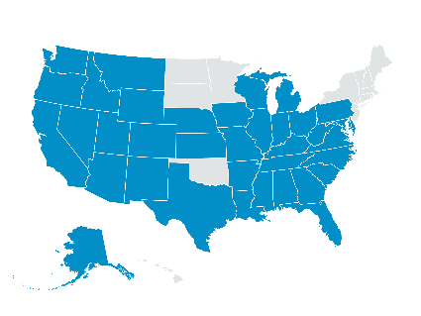
WE GET A LOT OF DATA…
2,778 STORES IN 35 STATES
60MM+
Households
1 OUT OF 2 HOUSEHOLDS IN THE US

Slide 3
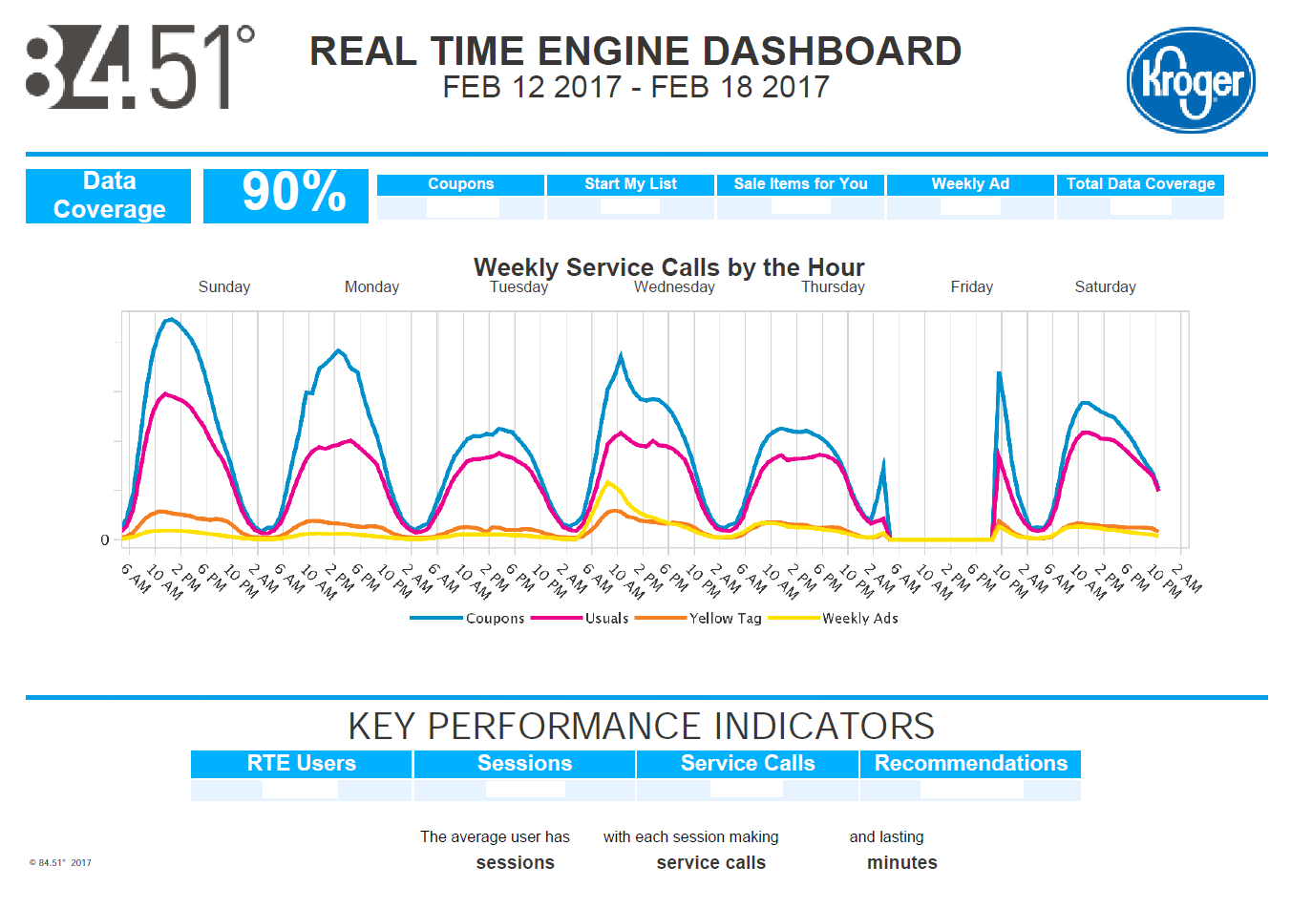
SOMETIMES YOU NEED A NICE VISUAL
Notes:
Now that SAS has added ODS graphics and has added the functionality of PROC LAYOUT, you can produce high quality graphics dynamically – no more using excel to generated charts…

Slide 4
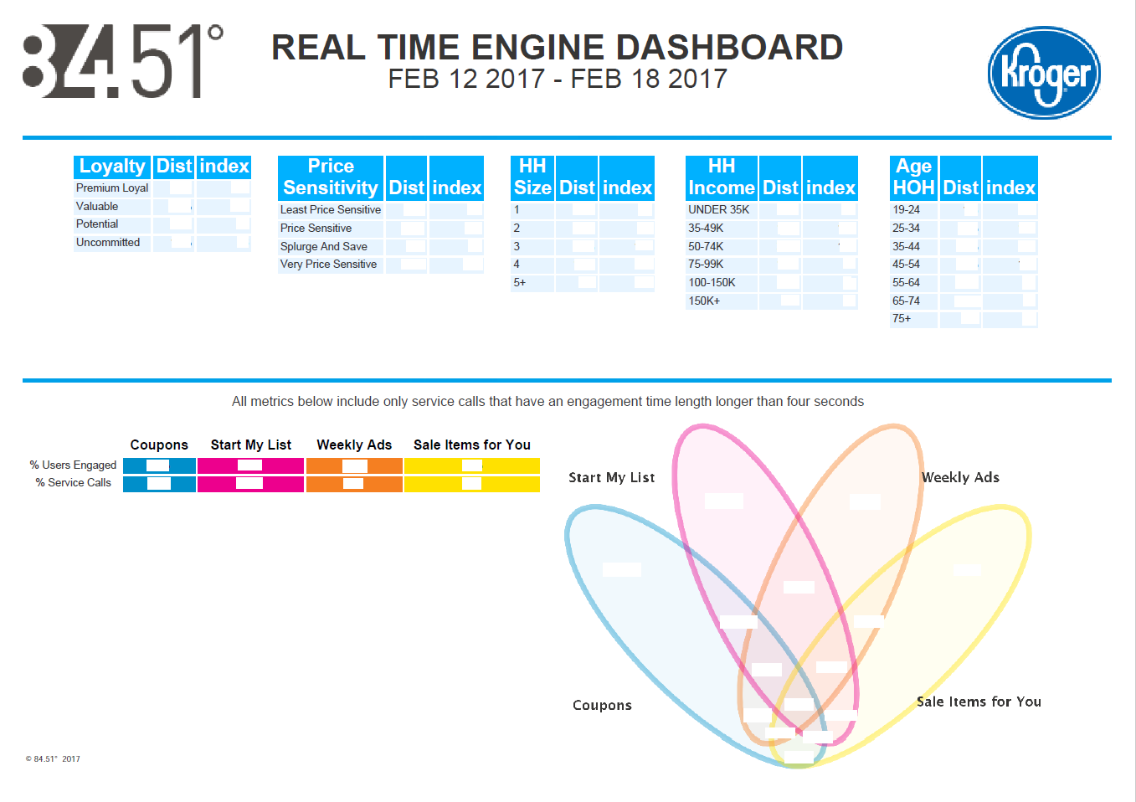
SOMETIMES YOU NEED A NICE VISUAL

Slide 5
COLOR COORDINATION
style GraphColors /
"gclipping" = cxD2D2D2
"gcclipping" = cx363534
"gstars" = cxD2D2D2
"gdata3" = CX20bc95
"gdata2" = CXd47ebd
"gdata1" = CX008FC9
"gdata" = CX008FC9;
end;
run;
proc template;
define style Styles.dh2;
parent = styles.dh;
/*this sets the line thickness for line charts*/
replace GraphReference / linethickness=10px;
style GraphFonts from _self_/
"GraphValueFont" = ("Helvetica",10pt)
"GraphTitleFont" = ("Helvetica",14pt,bold)
"GraphTitle1Font" = ("Helvetica",14pt,bold);
style colors /
"headerfgemph" = cx363534
"headerbgemph" = cxFFFFFF
"headerfgstrong" = cx363534
"contentfg" = cx363534
"contentbg" = cxFFFFFF
"docfg" = cx363534
"docbg" = cxffffff /*changing background*/
"gaxis" = CXD5D5D5
"gwalls" = CXFFFFFF;
Determine default styles using:
proc template; list; run;

Slide 6
BUILD YOUR LINE CHART WITH SGPLOT
ods graphics on /imagename="weekly_service_calls_&end_date_report" width=10.5in height=3in;
ods listing style=dh2 gpath = "&out_location" image_dpi = 300;
proc sgplot /*noautolegend*/ data=report1 ;
series x=datetime y=coupons /lineattrs= GraphData1 legendlabel='Coupons' break;
series x=datetime y=usuals / lineattrs= GraphData5 legendlabel='Usuals' break;
series x=datetime y=yellowtag / lineattrs= GraphData7 legendlabel='Yellow Tag' break;
series x=datetime y=weeklyads / lineattrs= GraphData9 legendlabel='Weekly Ads' break;
xaxis grid display=(nolabel) values=(&min. to &max. by 14400) fitpolicy=rotate tickvalueformat=timeampm5. ;
yaxis display=(nolabel) tickvalueformat=comma12. ;
run;
ods listing close;
ods graphics off;
Four hours, in seconds

Slide 7
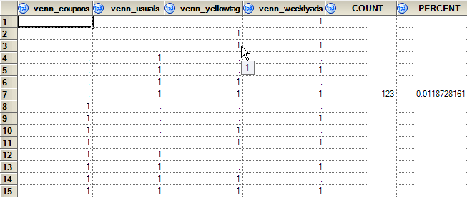
LET’S MAKE A VENN – DATA PREP SEE RESOURCES PAGE FOR ORIGINAL PAPER ‘V is for Venn Diagrams’ by Kriss Harris, SAS Specialists Ltd
Make a table that looks like this:
And then generate the macro variables
data work.venn;
set sasdata.report6_venn;
coupons=translate(translate(put(venn_coupons,1.),'A','1'),"",'.');
usuals=translate(translate(put(venn_usuals,1.),'B','1'),"",'.');
weekly=translate(translate(put(venn_weeklyads,1.),'C','1'),"",'.');
yellow=translate(translate(put(venn_yellowtag,1.),'D','1'),"",'.');
var=compress(coupons||usuals||weekly||yellow);
call symput(var,round(percent,.1));
run;
%put &A &B &C &D &AB &AC &AD &BC &BD &CD &ABC &ABD &ACD &BCD &ABCD;

Slide 8
LET’S MAKE A VENN – DATA PREP
Then we need to create a dummy table that’s a 100 by 100 matrix, that we’ll use later to position data points and ellipses in the graph
data chart_matrix;
do x = 1 to 100;
y = x;
output;
end;
run;

Slide 9
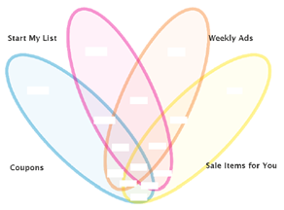
LET’S MAKE A VENN – BUILDING YOUR TEMPLATE
proc template;
define statgraph Venn4Way;
begingraph / drawspace=datavalue ;
/* Plot */
layout overlay / yaxisopts = (display = NONE) xaxisopts = (display = NONE) ;
scatterplot x=x y=y / markerattrs=(size = 0);
/* Venn Diagram (Ellipses) */
drawoval x=28 y=39 width=26 height=100 / display=all fillattrs=(color=CX008FC9 transparency=0.85) outlineattrs=(color=CX008FC9 thickness=6) transparency=0.60
WIDTHUNIT= Percent HEIGHTUNIT= Percent rotate = 45 ;
drawoval x=72 y=39 width=26 height=100 /display=all fillattrs=(color=CXFFE000 transparency=0.85) outlineattrs=(color=CXFFE000 thickness=6) transparency=0.60
WIDTHUNIT= Percent HEIGHTUNIT= Percent rotate = 315 ;
drawoval x=57 y=54 width=26 height=100 / display=all fillattrs=(color=CXf47e24 transparency=0.85) outlineattrs=(color=CXf47e24 thickness=6) transparency=0.60
WIDTHUNIT= Percent HEIGHTUNIT= Percent rotate = 335 ;
drawoval x=43 y=54 width=26 height=100 / display=all fillattrs=(color=CXec008b transparency=0.85) outlineattrs=(color=CXec008b thickness=6) transparency=0.60
WIDTHUNIT= Percent HEIGHTUNIT= Percent rotate = 25 ;

Slide 10
LET’S MAKE A VENN – BUILDING YOUR TEMPLATE CONTINUED
/* Values within the diagram */
drawtext textattrs = GRAPHVALUETEXT(size = 9pt weight = bold color=CX363534 ) "&A.%" / x=12 y=60 anchor=center;
drawtext textattrs = GRAPHVALUETEXT(size = 9pt weight = bold color=CX363534 ) "&B.%" / x=34 y=80 anchor=center;
drawtext textattrs = GRAPHVALUETEXT(size = 9pt weight = bold color=CX363534 ) "&C.%" / x=64 y=80 anchor=center;
drawtext textattrs = GRAPHVALUETEXT(size = 9pt weight = bold color=CX363534 ) "&D.%" / x=86 y=60 anchor=center;
drawtext textattrs = GRAPHVALUETEXT(size = 9pt weight = bold color=CX363534 ) "&AB.%" / x=37 y=45 anchor=center;
drawtext textattrs = GRAPHVALUETEXT(size = 9pt weight = bold color=CX363534 ) "&AC.%" / x=41 y=18 anchor=center;
drawtext textattrs = GRAPHVALUETEXT(size = 9pt weight = bold color=CX363534 ) "&AD.%" / x=50 y=6 anchor=center;
drawtext textattrs = GRAPHVALUETEXT(size = 9pt weight = bold color=CX363534 ) "&BC.%" / x=50 y=55 anchor=center;
drawtext textattrs = GRAPHVALUETEXT(size = 9pt weight = bold color=CX363534 ) "&BD.%" / x=59 y=18 anchor=center;
drawtext textattrs = GRAPHVALUETEXT(size = 9pt weight = bold color=CX363534 ) "&CD.%" / x=65 y=45 anchor=center;
drawtext textattrs = GRAPHVALUETEXT(size = 9pt weight = bold color=CX363534 ) "&ABC.%" / x=43 y=31 anchor=center;
drawtext textattrs = GRAPHVALUETEXT(size = 9pt weight = bold color=CX363534 ) "&ABD.%" / x=57 y=32 anchor=center;
drawtext textattrs = GRAPHVALUETEXT(size = 9pt weight = bold color=CX363534 ) "&ACD.%" / x=46 y=13 anchor=center;
drawtext textattrs = GRAPHVALUETEXT(size = 9pt weight = bold color=CX363534 ) "&BCD.%" / x=54 y=12 anchor=center;
drawtext textattrs = GRAPHVALUETEXT(size = 9pt weight = bold color=CX363534 ) "&ABCD.%" /x=50 y=21 anchor=center;
/* Labels */
drawtext textattrs = GRAPHVALUETEXT(size = 10pt weight = bold color=CX363534 ) "&GroupA" / x=8 y=19 anchor=center width = 30;
drawtext textattrs = GRAPHVALUETEXT(size = 10pt weight = bold color=CX363534 ) "&GroupB" / x=10 y=85 anchor=center width = 30;
drawtext textattrs = GRAPHVALUETEXT(size = 10pt weight = bold color=CX363534 ) "&GroupC" / x=85 y=85 anchor=center width = 30;
drawtext textattrs = GRAPHVALUETEXT(size = 10pt weight = bold color=CX363534 ) "&GroupD" / x=89 y=20 anchor=center width = 30;
endlayout;
endgraph;
end;
run;

Slide 11
LET’S MAKE A VENN – BUILD THE GRAPH WITH SGRENDER
/*I set the height and width below - even though you're supposed to be able to do it in the ods text, it's just much easier here*/
ods graphics on / reset = all border = off width=5in height=3.75in imagefmt = png
imagename = "venn_&end_date_report.";
ods listing style=dh gpath = "&out_location" image_dpi = 300;
proc sgrender data=work.chart_matrix template=Venn4Way;
title 'User Distribution by Science';
run;
ods listing close;
ods graphics off;

Slide 12
PULLING IT ALL TOGETHER – PDF SETUP
Options orientation=landscape
topmargin='.25in'
bottommargin='.25in'
leftmargin='.25in'
rightmargin='.25in'
nodate /*gets rid of the date and timestamp*/
nonumber; /*removes page number*/
title; /*blanking out title otherwise it would say The SAS System*/
ods pdf file=“&path./rte_dashboard_&start_date_yr.&end_date_mon.&end_date_day..pdf" style=dh2
STARTPAGE=no; /*gets rid of blank start page*/
ODS escapechar="^";
ODS Layout start width=11 in height=8.5 in;
See RESOURCE page for more information about escape characters

Slide 13
PULLING IT ALL TOGETHER – PDF SETUP
Options orientation=landscape
topmargin='.25in'
bottommargin='.25in'
leftmargin='.25in'
rightmargin='.25in'
nodate /*gets rid of the date and timestamp*/
nonumber; /*removes page number*/
title; /*blanking out title otherwise it would say The SAS System*/
ods pdf file=“&path./rte_dashboard_&start_date_yr.&end_date_mon.&end_date_day..pdf" style=dh2
STARTPAGE=no; /*gets rid of blank start page*/
ODS escapechar="^";
ODS Layout start width=11 in height=8.5 in;
See RESOURCE page for more information about escape characters

Slide 14
PULLING IT ALL TOGETHER – PDF SETUP
ODS REGION x=0 y=0 width=3 in ;
ODS PDF text="^S={preimage=‘&path./8451_logo.png'}";
ODS REGION x=90pct y=0 width=2 in ;
ODS PDF text="^S={preimage=‘&path./kroger_logo.png'}";
ODS REGION x=0 y=15 width=11.5in ;
ODS PDF text="^S={fontsize=26pt font_weight=BOLD just=c}REAL TIME ENGINE DASHBOARD";
ODS PDF text="^S={fontsize=20pt font_weight=Medium just=c}&start_date_mon. &start_date_day. &start_date_yr. - &end_date_mon. &end_date_day. &end_date_yr.";
ODS REGION x=0 y=1.1in width=10.8in;
ODS PDF text="^S={preimage=‘&path./rte_reporting/blue_line.png'}";

Slide 15
PULLING IT ALL TOGETHER – PDF SETUP
Options orientation=landscape
topmargin='.25in'
bottommargin='.25in'
leftmargin='.25in'
rightmargin='.25in'
nodate /*gets rid of the date and timestamp*/
nonumber; /*removes page number*/
title; /*blanking out title otherwise it would say The SAS System*/
ods pdf file=“&path./rte_dashboard_&start_date_yr.&end_date_mon.&end_date_day..pdf" style=dh2
STARTPAGE=no; /*gets rid of blank start page*/
ODS escapechar="^";
ODS Layout start width=11 in height=8.5 in;
See RESOURCE page for more information about escape characters

Slide 16
PULLING IT ALL TOGETHER – PDF BUILD
Setting the line chart into the PDF file:
ODS REGION x=6pct y=2.1in width=10in;
ODS PDF text="^S={fontsize=16pt font_weight=bold just=c} Weekly Service Calls by the Hour";
ODS PDF text="^S={fontsize=10pt font_weight=medium just=c}Sunday Monday Tuesday Wednesday Thursday Friday Saturday";
ODS REGION x=2pct y=2.5in width=10.6in height=3.1in;
ODS PDF text="^S={preimage=‘&path./weekly_service_calls_&end_date_report..png'}";

Slide 17
PULLING IT ALL TOGETHER – PDF BUILD
Leverage PROC REPORT to generate the other reporting sections, e.g.:
/*KPIs*/
ODS REGION x=0 y=6.2in width=11.5in;
ODS PDF text="^S={fontsize=24pt font_weight=light just=c} KEY PERFORMANCE INDICATORS";
ODS REGION x=0 y=6.5in width=11.5in;
proc report data=work.kpi1 nowd style(header)={background=CX00B1FD foreground=CXFFFFFF}
style(column)={background=CXe6f3ff font_weight=medium width=2in just=c fontsize=10pt}
style(report)={background=CXFFFFFF just=c};
column total_users total_service_calls total_sessions tot_recos;
run ;

Slide 18
PULLING IT ALL TOGETHER – PDF BUILD
Place footnotes and terminate the page by ending the layout:
/*footnote*/
ODS REGION x=0 y=97pct width=1.5in;\
DS PDF text="^S={fontsize=6pt font_weight=light just=l} © 84.51°&curr_year. | Confidential";
ODS Layout end;

Slide 19
PULLING IT ALL TOGETHER – PDF BUILD
Starting a second page:
ods pdf STARTPAGE=now;
ODS Layout start width=11 in height=8.5 in;
/*start header here*/

Slide 20
PULLING IT ALL TOGETHER – PDF BUILD
Putting our reports in a row:
/*loyalty/shabit*/
ODS REGION x=.5in y=1.3in width=2in;
proc report data=work.shabit nowd style(header)={background=CX00B1FD foreground=CXFFFFFF}
style(column)={background=CXe6f3ff font_weight=medium}
style(report)={background=CXFFFFFF just=l
column shabit dist index;
run ;
/*priceband*/
ODS REGION x=2.6in y=1.3in width=2.2in;
proc report data=work.price nowd style(header)={background=CX00B1FD foreground=CXFFFFFF}
style(column)={background=CXe6f3ff font_weight=medium}
style(report)={background=CXFFFFFF just=l};
column priceband dist index;
run ;
..in this case, the background is actually the grid lines, which we're setting to white. We're also left justifying so it will go in the layout box nicely
WASH, RINSE, REPEAT…

Slide 21
PULLING IT ALL TOGETHER – PDF BUILD
Throwing in the Venn:
ODS REGION x=50pct y=4in width=5.1in height=3.85in;
ODS PDF text="^S={preimage='&path./venn_&end_date_report..png'}";

Slide 22
PULLING IT ALL TOGETHER – GET IT OUT THE DOOR!
filename outbox email
to='DigitalMission@8451.com'
from='jeff.ahrnsen@8451.com'
subject="Real Time Engine Dashboard &start_date_mon. &start_date_day. &start_date_yr. - &end_date_mon. &end_date_day. &end_date_yr."
attach=“&path./rte_dashboard_&start_date_yr.&end_date_mon.&end_date_day..pdf";
data _null_;
file outbox;
put 'Attached please find the most recent dashboard for the Real Time Engine.';
put '';
put 'Thank you';
run;

Slide 23
RESOURCES
PROC TEMPLATE: http://www2.sas.com/proceedings/sugi31/112-31.pdf
ODS ESCAPECHAR: http://www2.sas.com/proceedings/forum2007/099-2007.pdf
ODS LAYOUT: https://support.sas.com/resources/papers/proceedings15/SAS1836-2015.pdf
FOUR WAY VENN: http://support.sas.com/resources/papers/proceedings13/243-2013.pdf

Slide 24
QUESTIONS?
contact: jeff.ahrnsen@8451.com

